Slide 1
Dorchester Cricket Club
1961 – 2011
Fifty and Out

Slide 2
Batting Order
What tonight is all about
History of the Club
The last game
Some Quick Statistics
Buffet
My DCC years – first ball calamities, 6 hitting heaven, Dads & Lads, famous opponents, 12th Man Challenge , website, the best DCC match and the worst DCC cricketer announced.
Players, the Hall of fame & 50 year presentations (with raffle)

Slide 3
1961-2011
A long, long time.........

Slide 4
Boys to Men

Slide 5
Boys to men

Slide 6
Smaller men to Bigger men

Slide 7
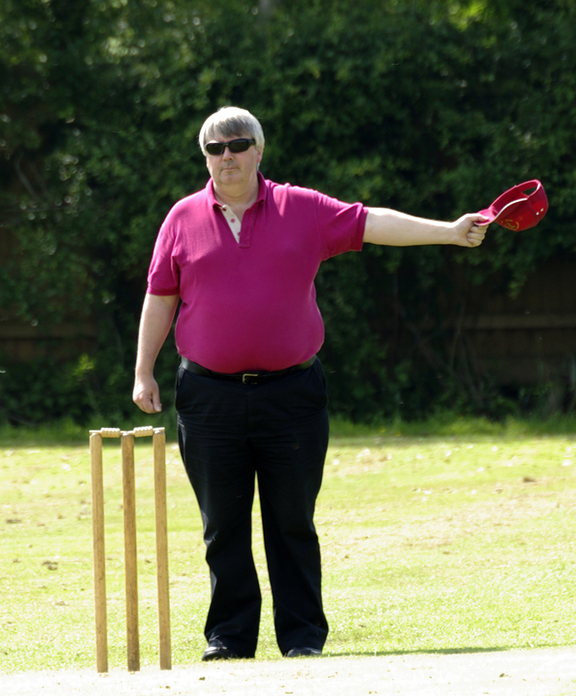
Bigger men to even bigger men

Slide 8
Great Physiques

Slide 9
Tales of Slogging

Slide 10
Drunken Laughter

Slide 11
More Laughs

Slide 12
Stories of Big Hitting

Slide 13
Memories from the Middle

Slide 14
BUT MORE THAN ANYTHING... Happy memories for all!

Slide 15
1961-2011
DCC memories
HEALTH WARNING!!

Slide 16
The History of DCC
1961 to
2011

Slide 19
Mrs Bostock -
Why we are all here

Slide 20
Our 1st DCC Great – Roy Clark

Slide 21
A chat with Roy
Sherwood Inn & Vernon Arms
Holy Trinity from Ilkeston – Competitive Vicar
Frank Mackley & the kit
KICC
Inham Nook complaint

Slide 22
Day Trip to Holbeach CC – mid sixties

Slide 23
DCC in the late Sixties and early Seventies
Type of game
Runs scored

Slide 24
Richard ‘Dick Grimes’

Slide 25
Peggy Grimes – Honorary Life Member

Slide 27
6 a side runners 1979 South Muskham & Little Carlton

Slide 28
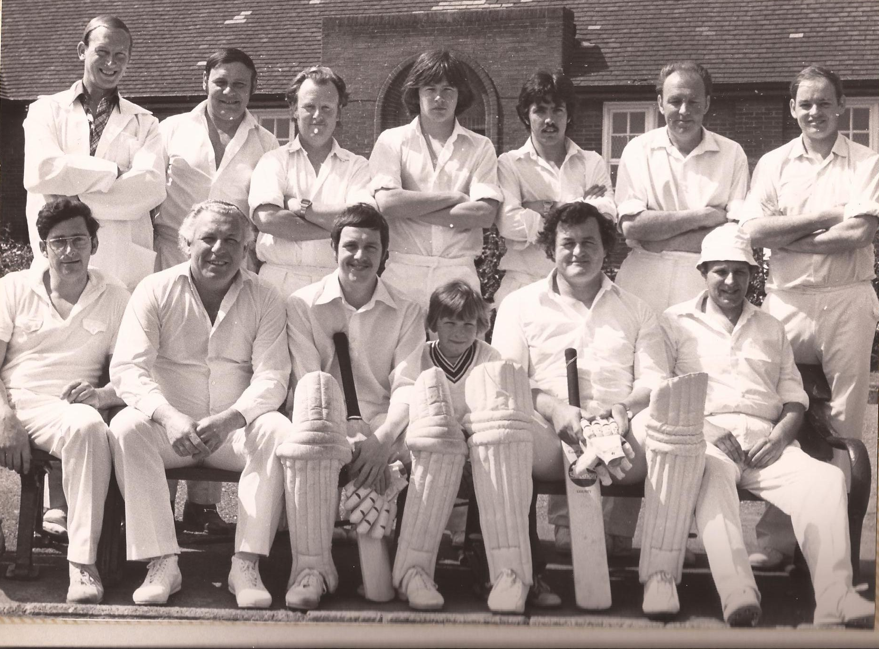

Slide 29
Fernwood School 1983

Slide 30
1984 – all change

Slide 31
Late 1980’s - 1988

Slide 32
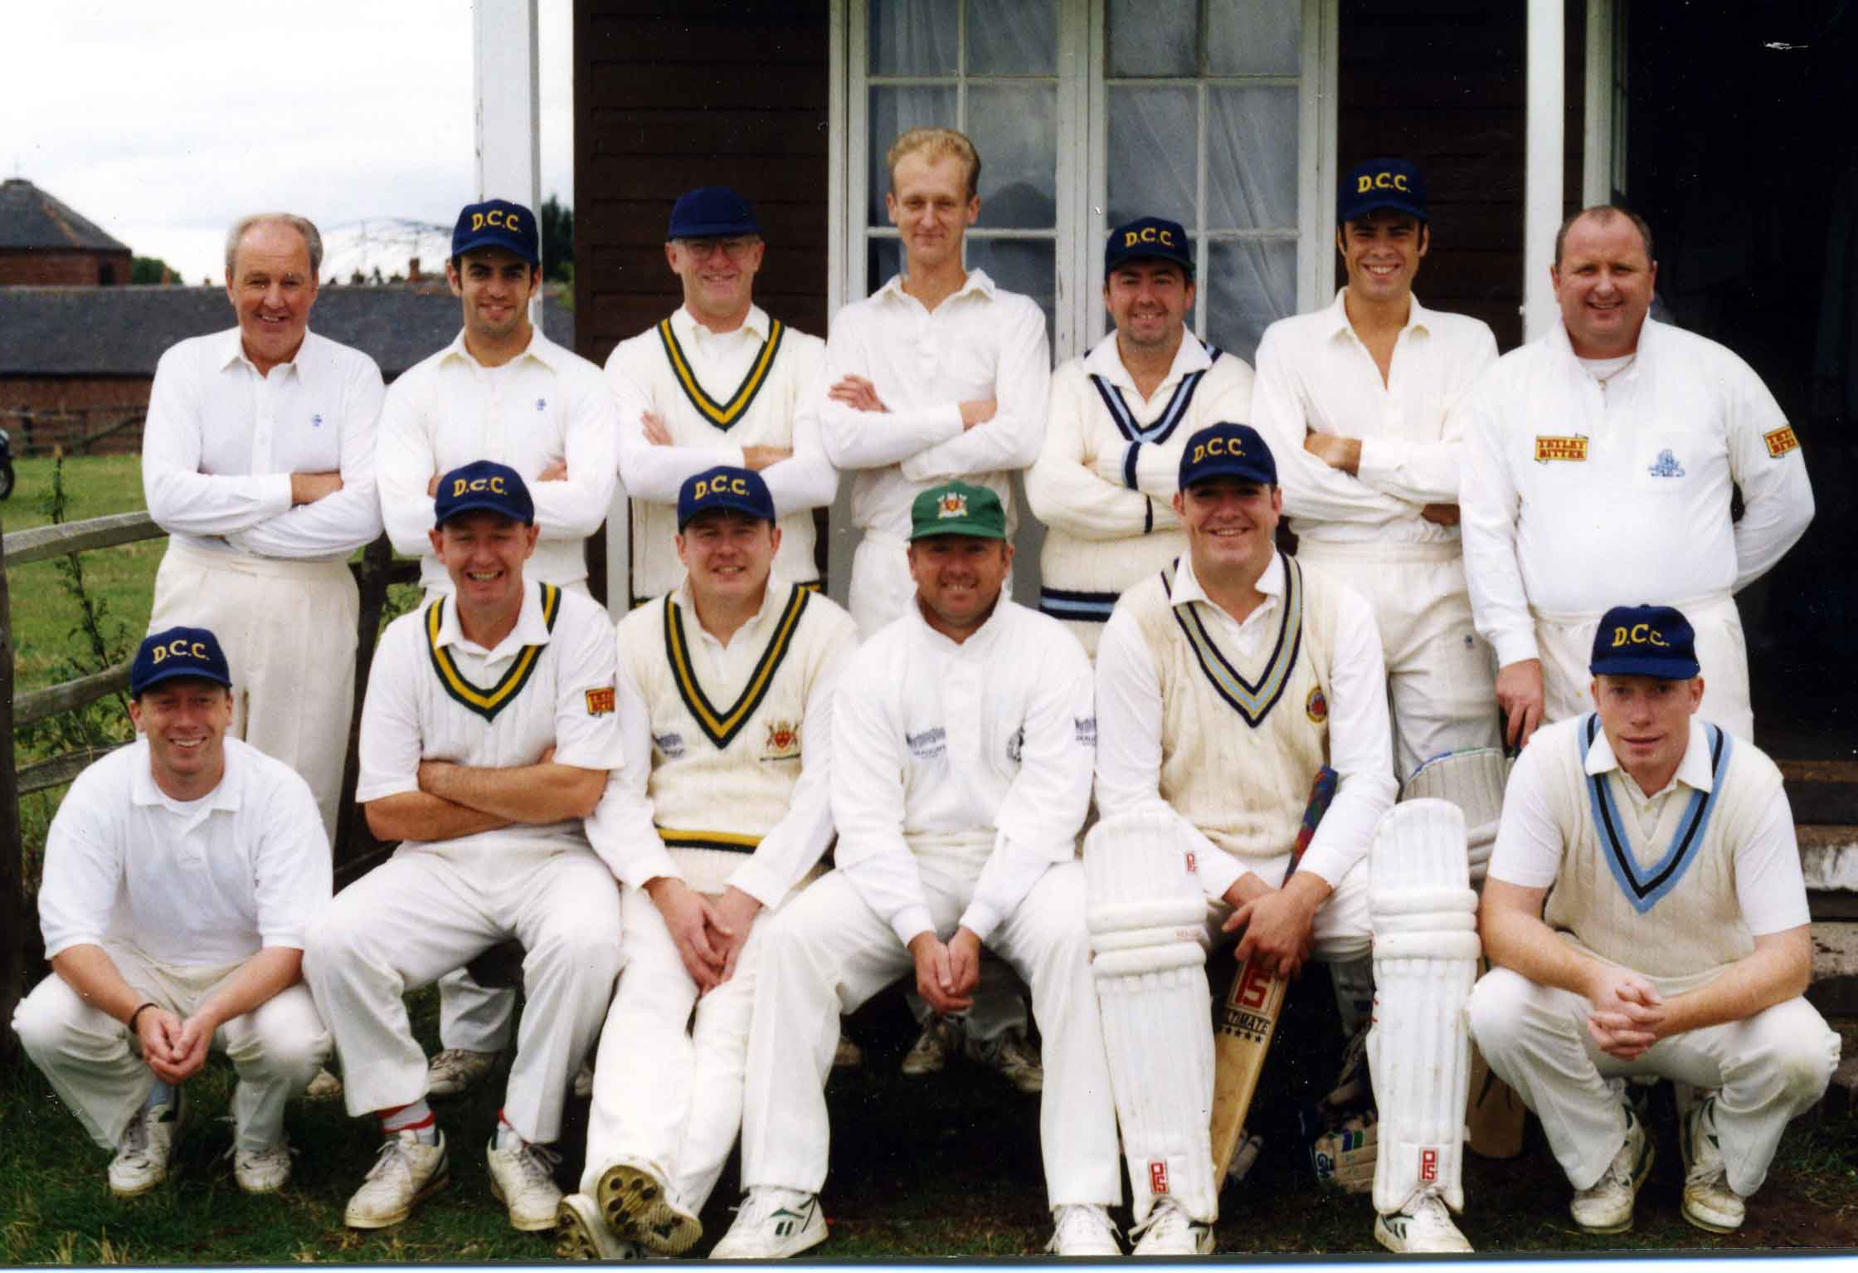
The 1990’s

Slide 33
Golden Udder and the Baggy Greens vs Skegness town

Slide 34
2005 reduced fixtures

Slide 35
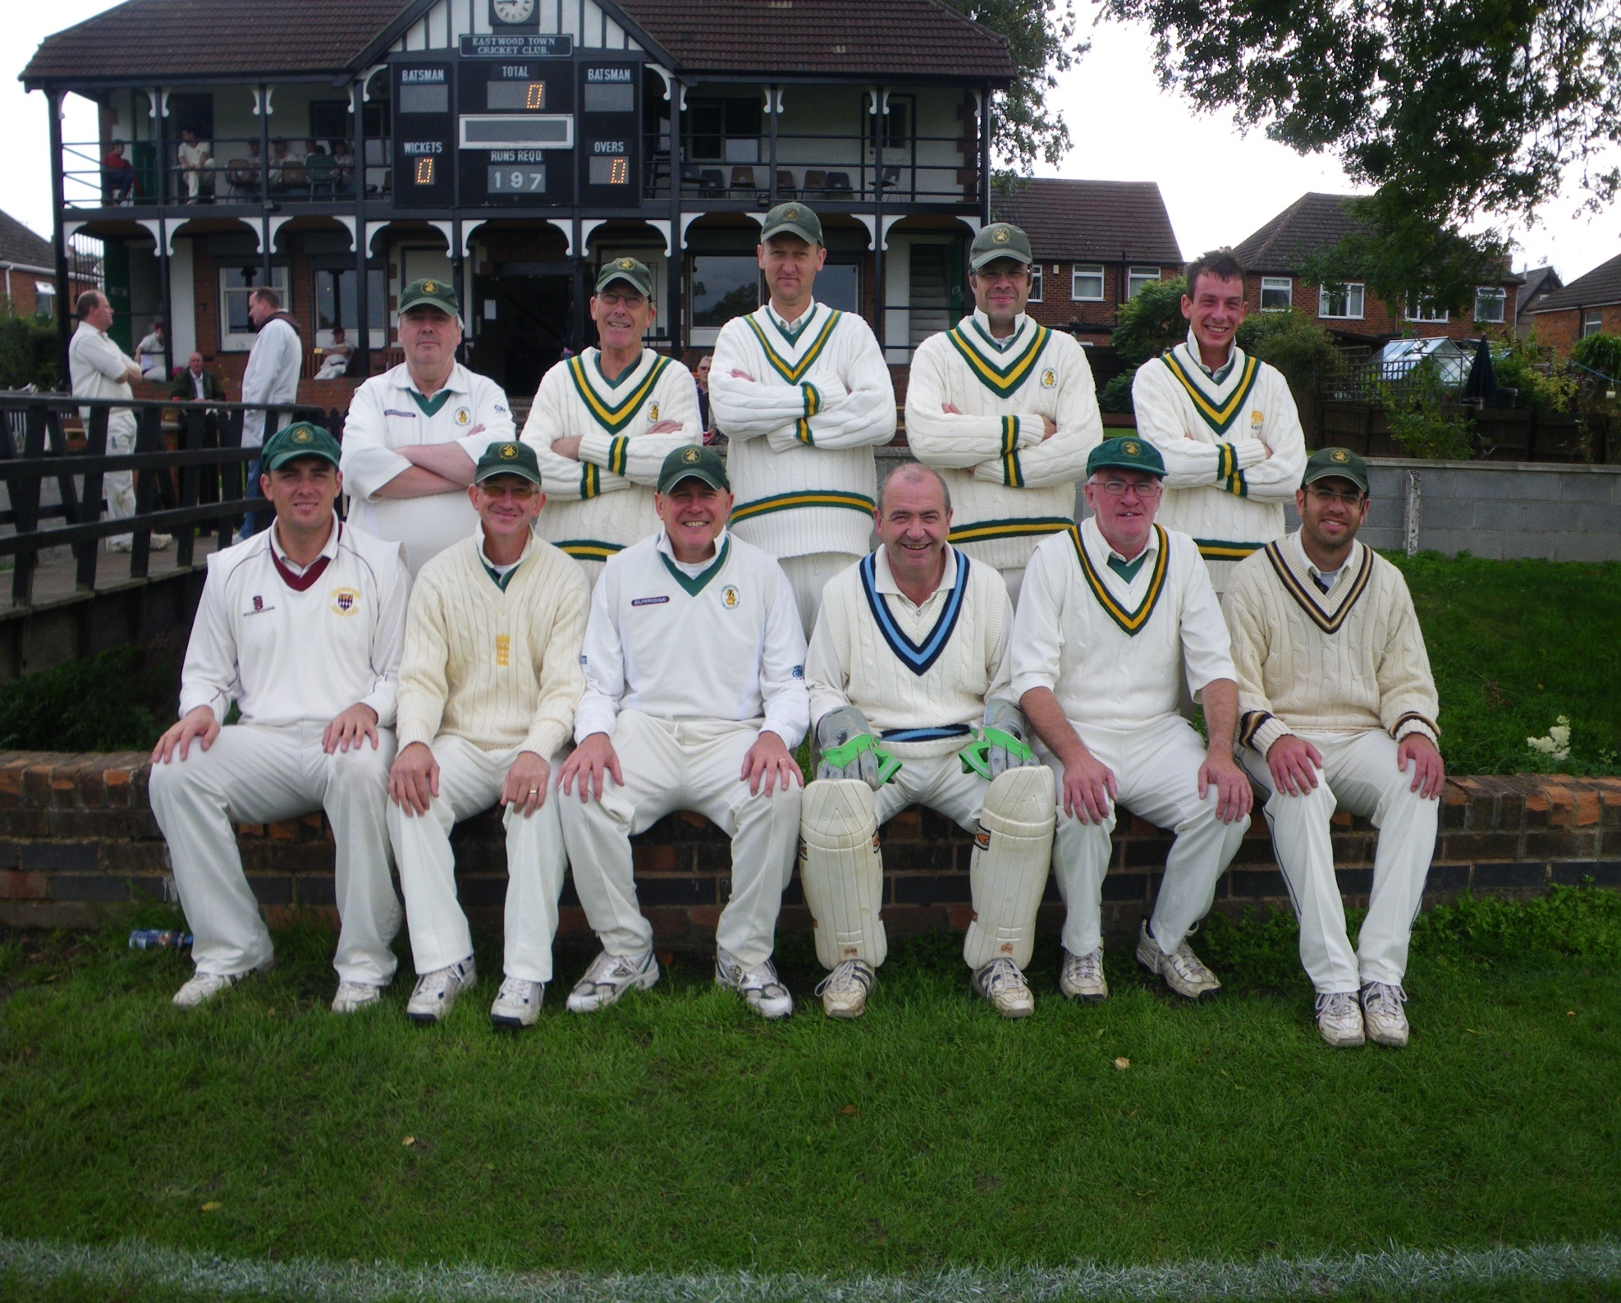

Slide 36
Through all those Years...
Home Grounds
BHOB & Dorford CC
Quality of fixtures
What the club was known for
Social – Beetle, Quizzes & The Annual Do’s
Identity -

Slide 37
Annual Do’s
The Commodore
City and Borough Club
Bowling Green Pub
Savoy Hotel
Polish Club
Dorchester Club
Loopers
Bestwood Lodge
The Lodge
Hucknall
Irish Club
3 Horseshoes Beeston
Ramsdale Park
The Rhinegold
Turners Banqueting Suite
Oxclose Lane Police Station
Woodville Hotel
Mapperley Park Golf Club
Rolls Royce
Wagon and Horses Arnold
Stadium Leisure
Waltons
Chilwell Golf Club
Saracens Head at Southwell
Beeston Fields Golf Club

Slide 38
A Special Welcome
Dave & Diane

Slide 39
1961-2011
DCC memories

Slide 40
The Last Game

Slide 47
Trooping off for the last time

Slide 48
Just a few Statistics

Slide 49
Some stats
Highest Total scored
372-7 in 40 overs vs Anston 1998.
(won by 234 runs)
Lowest Total recorded
34 – 25/7/76
Vs BRSA Colwick
(were 15-1)
Heart failure
August 1991 at S. Wingfield
DCC 254-5
SW 253-7
(174-5 in 35^{th / 20 last over reqd})
Lowest score vs
32 – South Muskham
9/7/78

Slide 50
Bowling
ANDY GAUNT 7-13 vs Castle Donington 1994
TERRY ELSEY 7-19 vs Hucknall 1979
DAVE HARRISON 7-39 vs S Normanton 1980
Hat tricks – Jon Smith, Steve Gaunt, Dave Hibbert, Adam Street.
4 in 5 balls Andy Thomas vs Wellow 1988
Most wickets in a season T Elsey 65 in 1979

Slide 51
All time wicket partnerships
1st 197 Tim Norris / Ian Cross vs Grace Dieu 1991
2nd 283 Dean Blake / Paul Taylor vs Quorn 1999
3rd 174 Jamie Lees / Paul Taylor vs Ticknall 1995
4th 133 Dave Hibbert / Paul Taylor vs Kinoulton 1993
5th 138* Jeremy Flight & Jon Smith vs Mountsorrel Castle 2006
6th 120* Ian Cross /Dean Blake vs Belton 2003
7th 95 Steve Bennett / Jamie Lees vs Stanton 1997
8th 83 Ant Shipley / Jamie Lees Stoke Bardolph/B Joyce 1998
9th 65* Jon Smith / Kevin Brown Leicester Teachers 2006
10th 62* Jamie Lees & Mick Stewardson vs Eastwood 2006

Slide 52
Batting Highest Scores (all in 40 overs)
DEAN BLAKE 184 NO vs QUORN 1999
IAIN BAMBER 181 vs ANSTON 1998
JEREMY FLIGHT 179NO vs Mountsorrel 2006
Most runs in a season 905 – Andrew Inkster 1988

Slide 53
666664 – Iain Bamber – a note from NZ
.

Slide 54
Buffet TIME Back in 35 minutes

Slide 55
My DCC Years
First ball calamities
Dads & Lads
The Inkster factor
Worst DCC cricketer
Social
Fun on the pitch
Best ever match?
The Twelfth Man Challenge

Slide 56
First Ball Calamities – 3 Classic Moments
.

Slide 57
Dads and Lads
Gary & Colin Franks
Mark & George Wootton
Bradley & Paul Taylor
Jordan & James Lees
Craig & Gareth Lewis
Steve & Pat Healy
Adam & Alec Street
Ben & Ant Shipley
Ian & Dave Cross

Slide 58
Dads & Lads

Slide 59
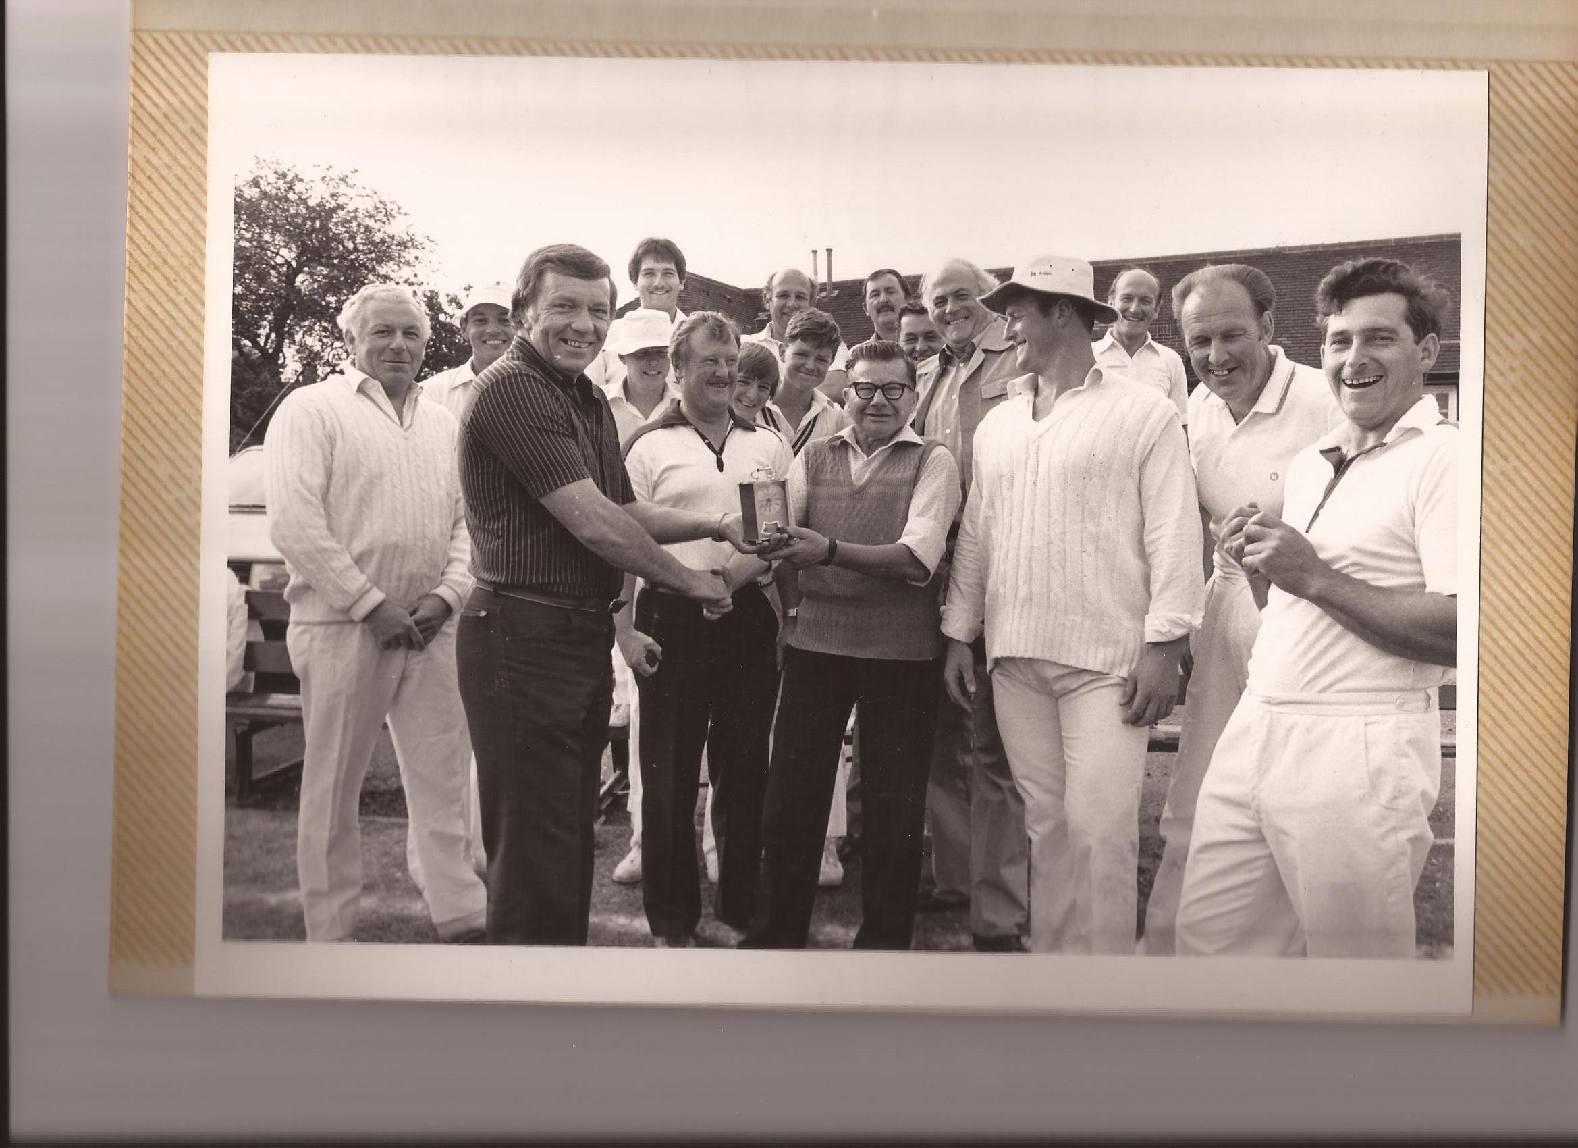

Slide 60
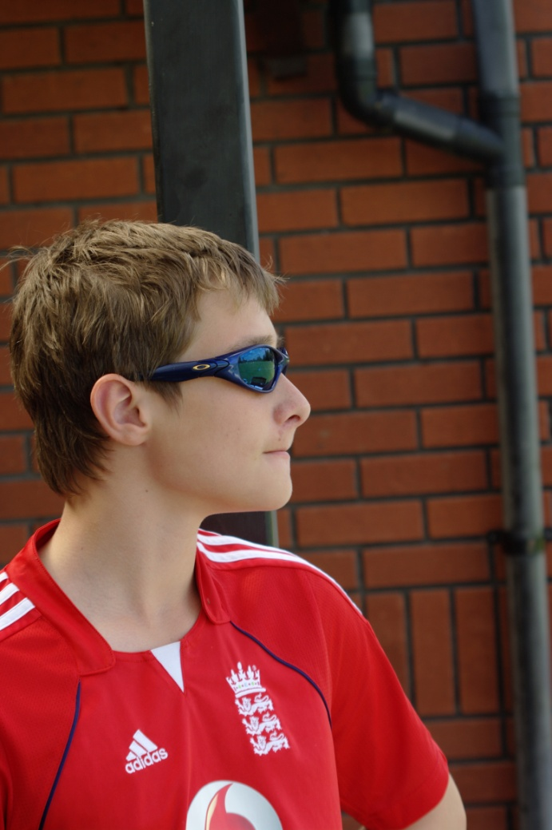
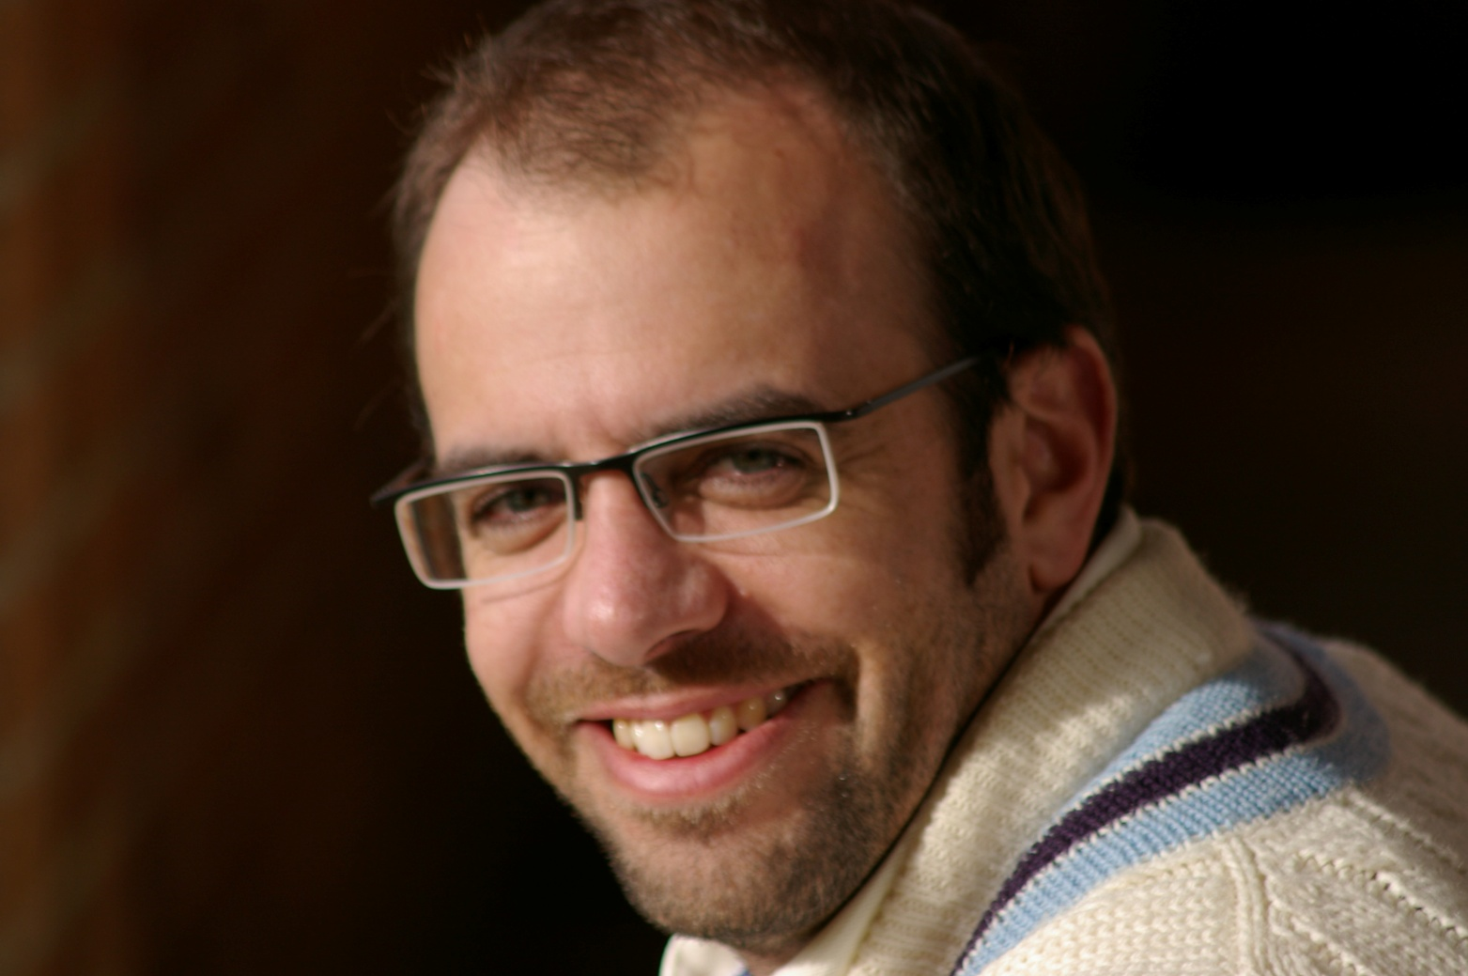
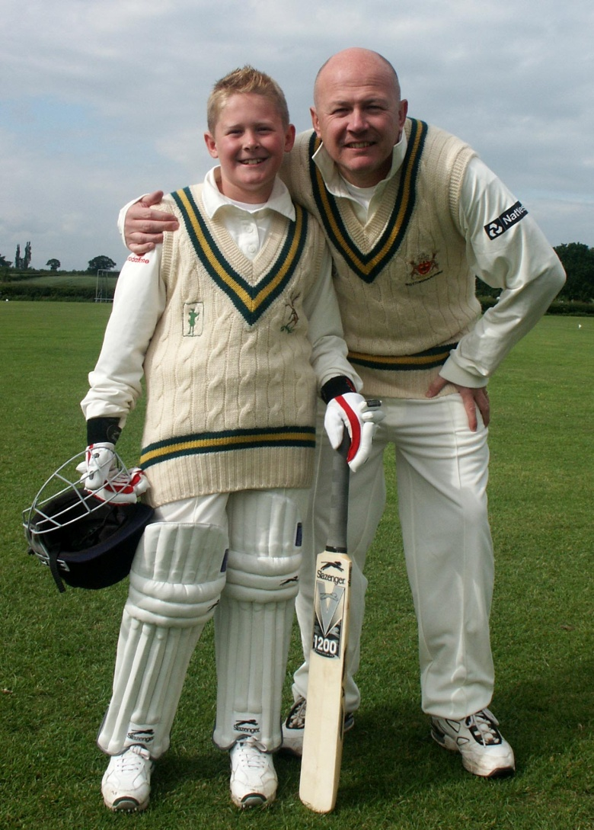
.

Slide 63
Winner of DCC’s Worst ever Cricketer is....
Runner up – Paul Atkins
Winner – Lee Allsopp

Slide 67
Fun on the pitch
Non- bowlers competition 50p in
Pink headband
Fantasy league
Influenced on field behaviours?

Slide 68
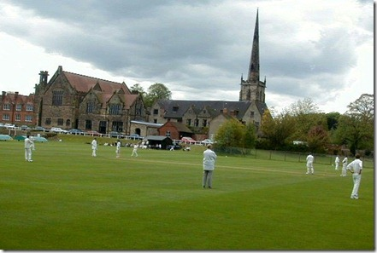
Favourite & Famous Opponents

Slide 69
Best Ever DCC Match
2/7/06
Vs Leicester Teachers

Slide 70
Best Ever Game?
Blazing hot
LTCC scored 200 all out in 42 overs
We had 38 overs to knock them off
58-1 became 138-8 in the 28th
Smudge & Brown Dog senior to the rescue
When pressure on Mr Mohammed denied agreement of 8 overs per bowler
Claimed 4 wickets – unlikely 16 from last over
2 1 5 (Kev) 2 2 ..........so... 4 to win off last ball.........

Slide 71
...’you can do it Jonny’

Slide 72
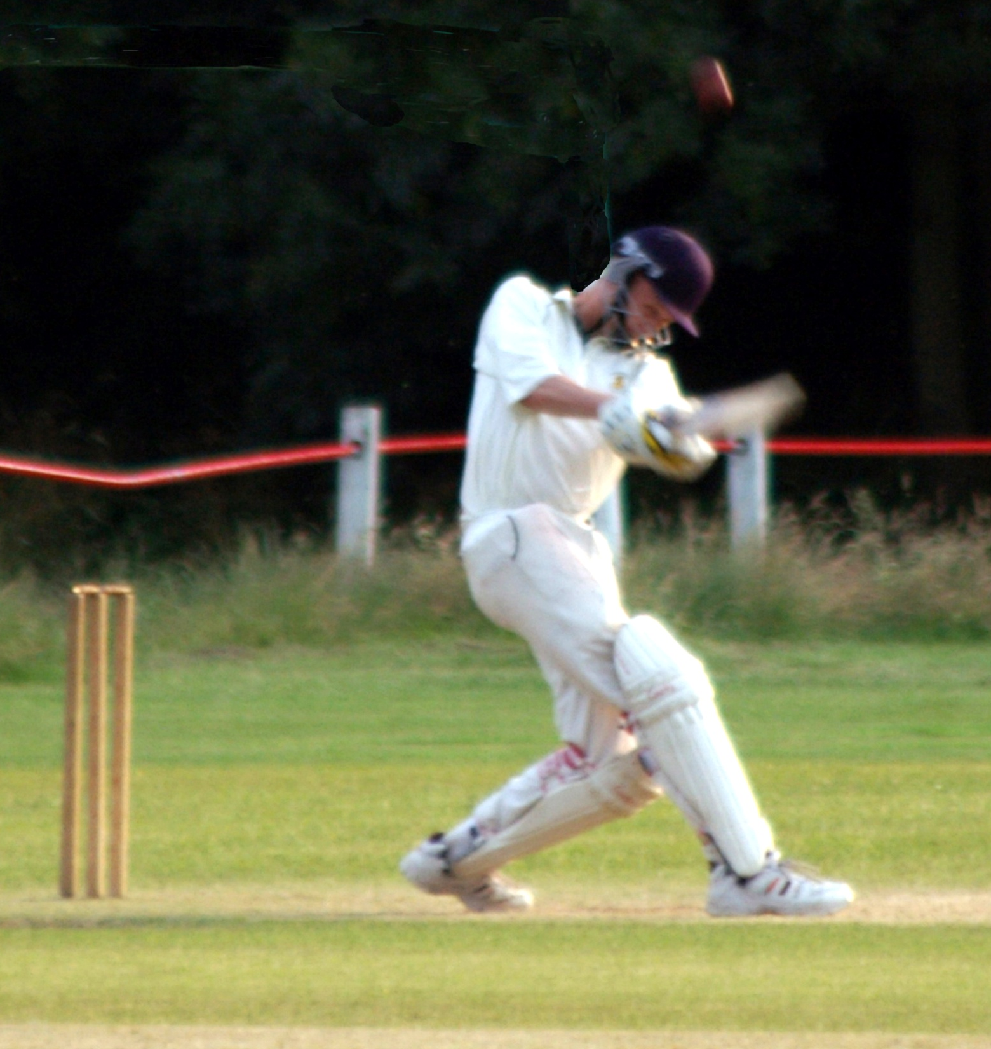

Slide 73
“Oh my God....I did it!”

Slide 74
Twelfth man challenge
Rob, Benno & Smudge

Slide 75
What next? Tonight on the Website / Booklet / Friends of DCC
.

Slide 76
Dorchester Cricket Club 1961-2011 Players
.

Slide 77
Ant Shipley
.

Slide 78
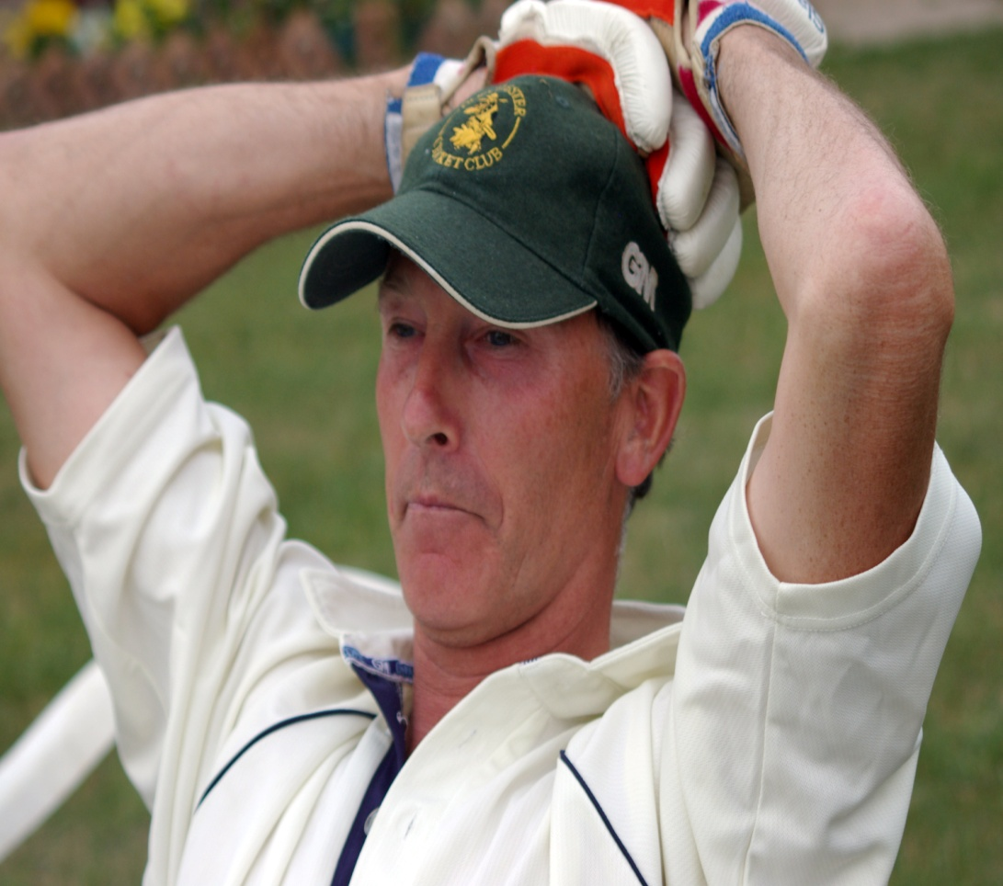
The Vicar

Slide 79
Guess the player?

Slide 80
????

Slide 81
Clive

Slide 82
Danny Brenan

Slide 83
Joe Allport

Slide 84
Bradley Taylor

Slide 85
Adam Street

Slide 86
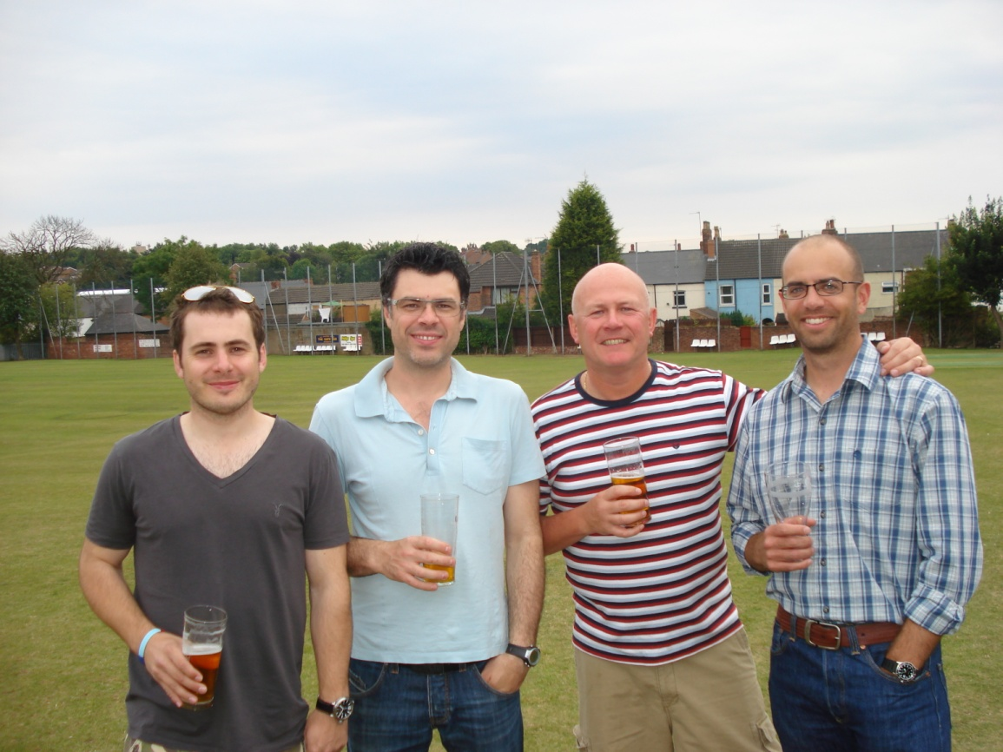
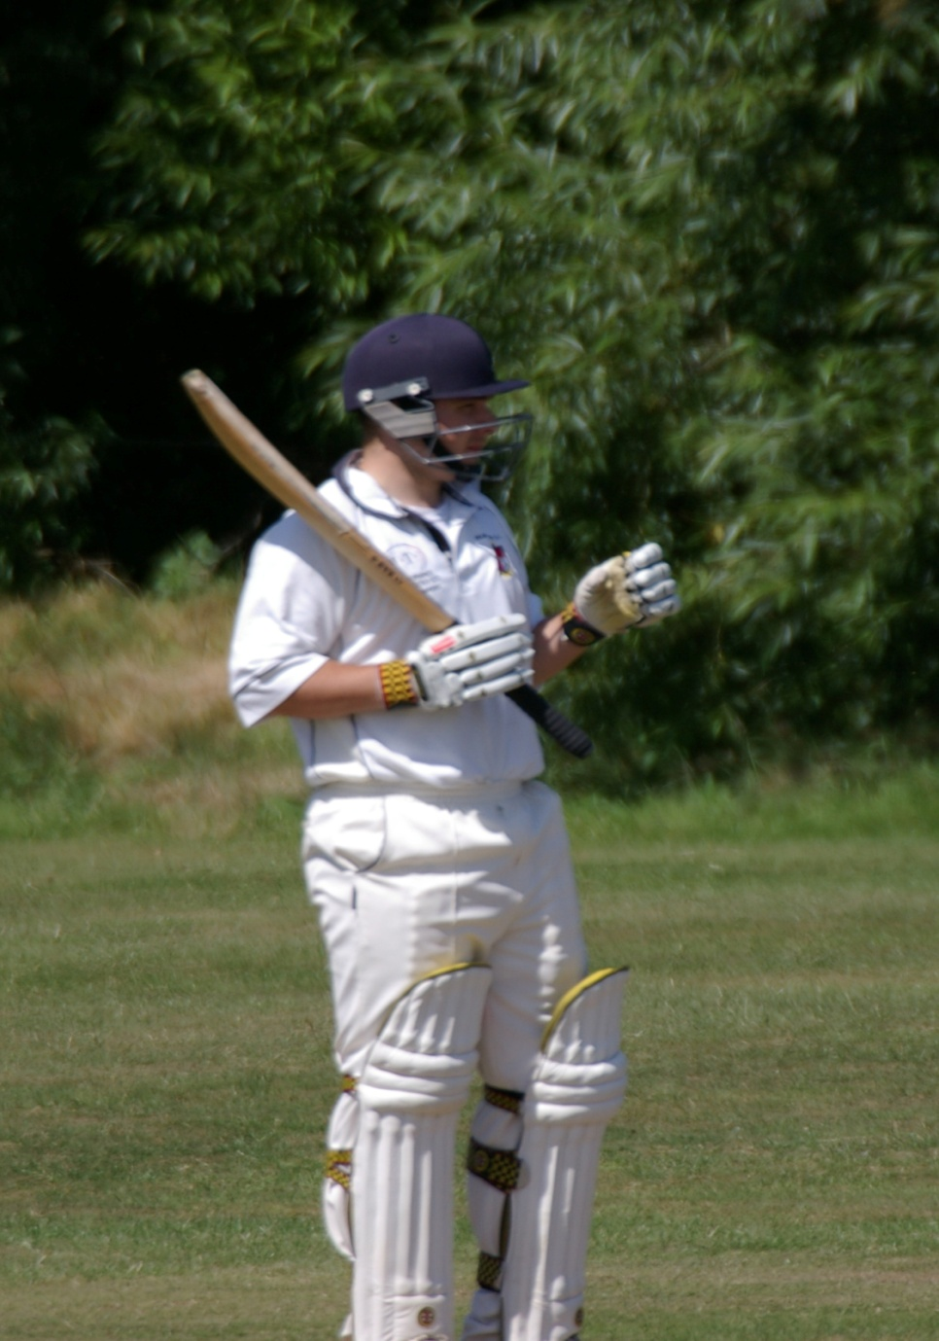
Nick Briars

Slide 87
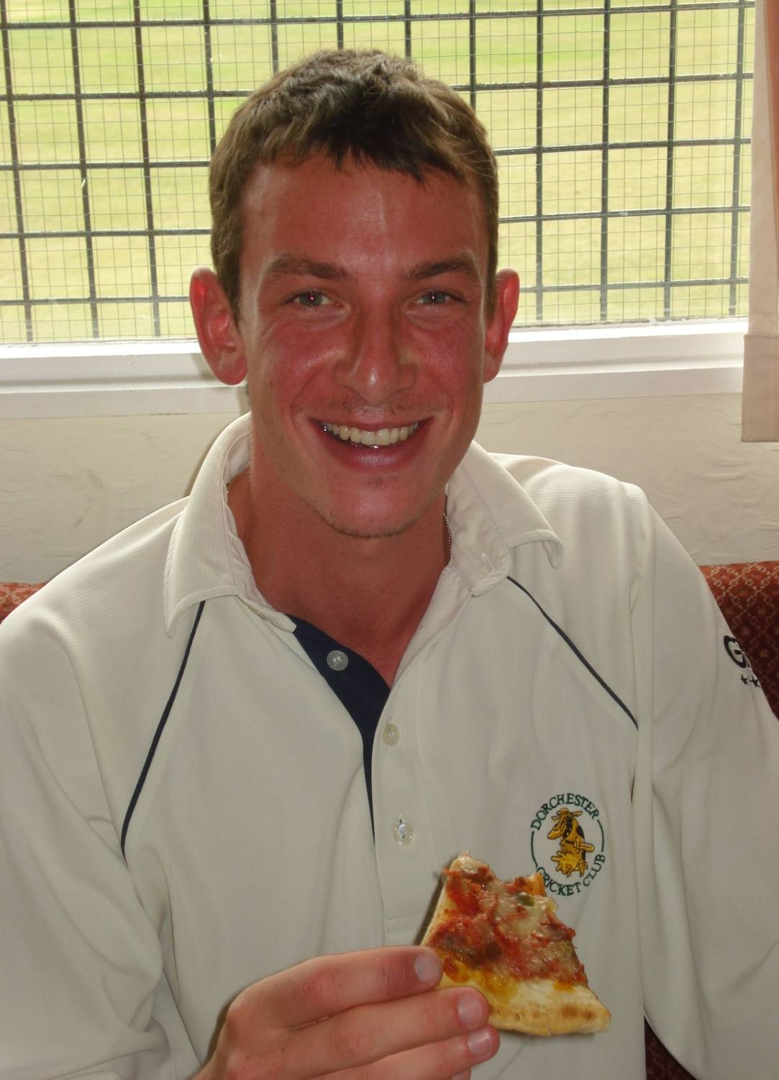
Richard Brown – ‘Brown Dog Junior’

Slide 88
Kevin Brown – Brown Dog Senior

Slide 89
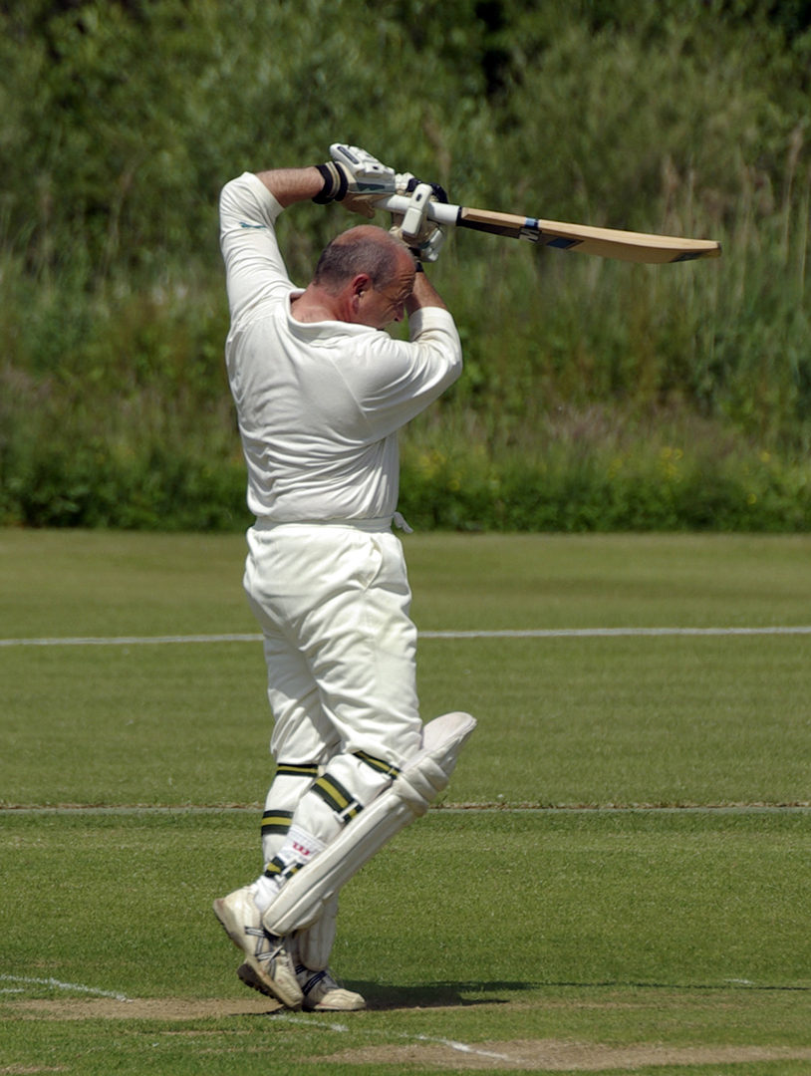
Adey Cooper

Slide 90
Dorchester Greats
...an explanation – on the pitch/off the pitch / games played and overall contribution

Slide 91
a D.C.C. ‘Great’

Slide 92
a D.C.C. ‘Great’

Slide 93
a D.C.C. ‘Great’

Slide 94
a D.C.C. ‘Great’

Slide 95
DCC Greats in our presence tonight
Guest presenters and award givers

Slide 96
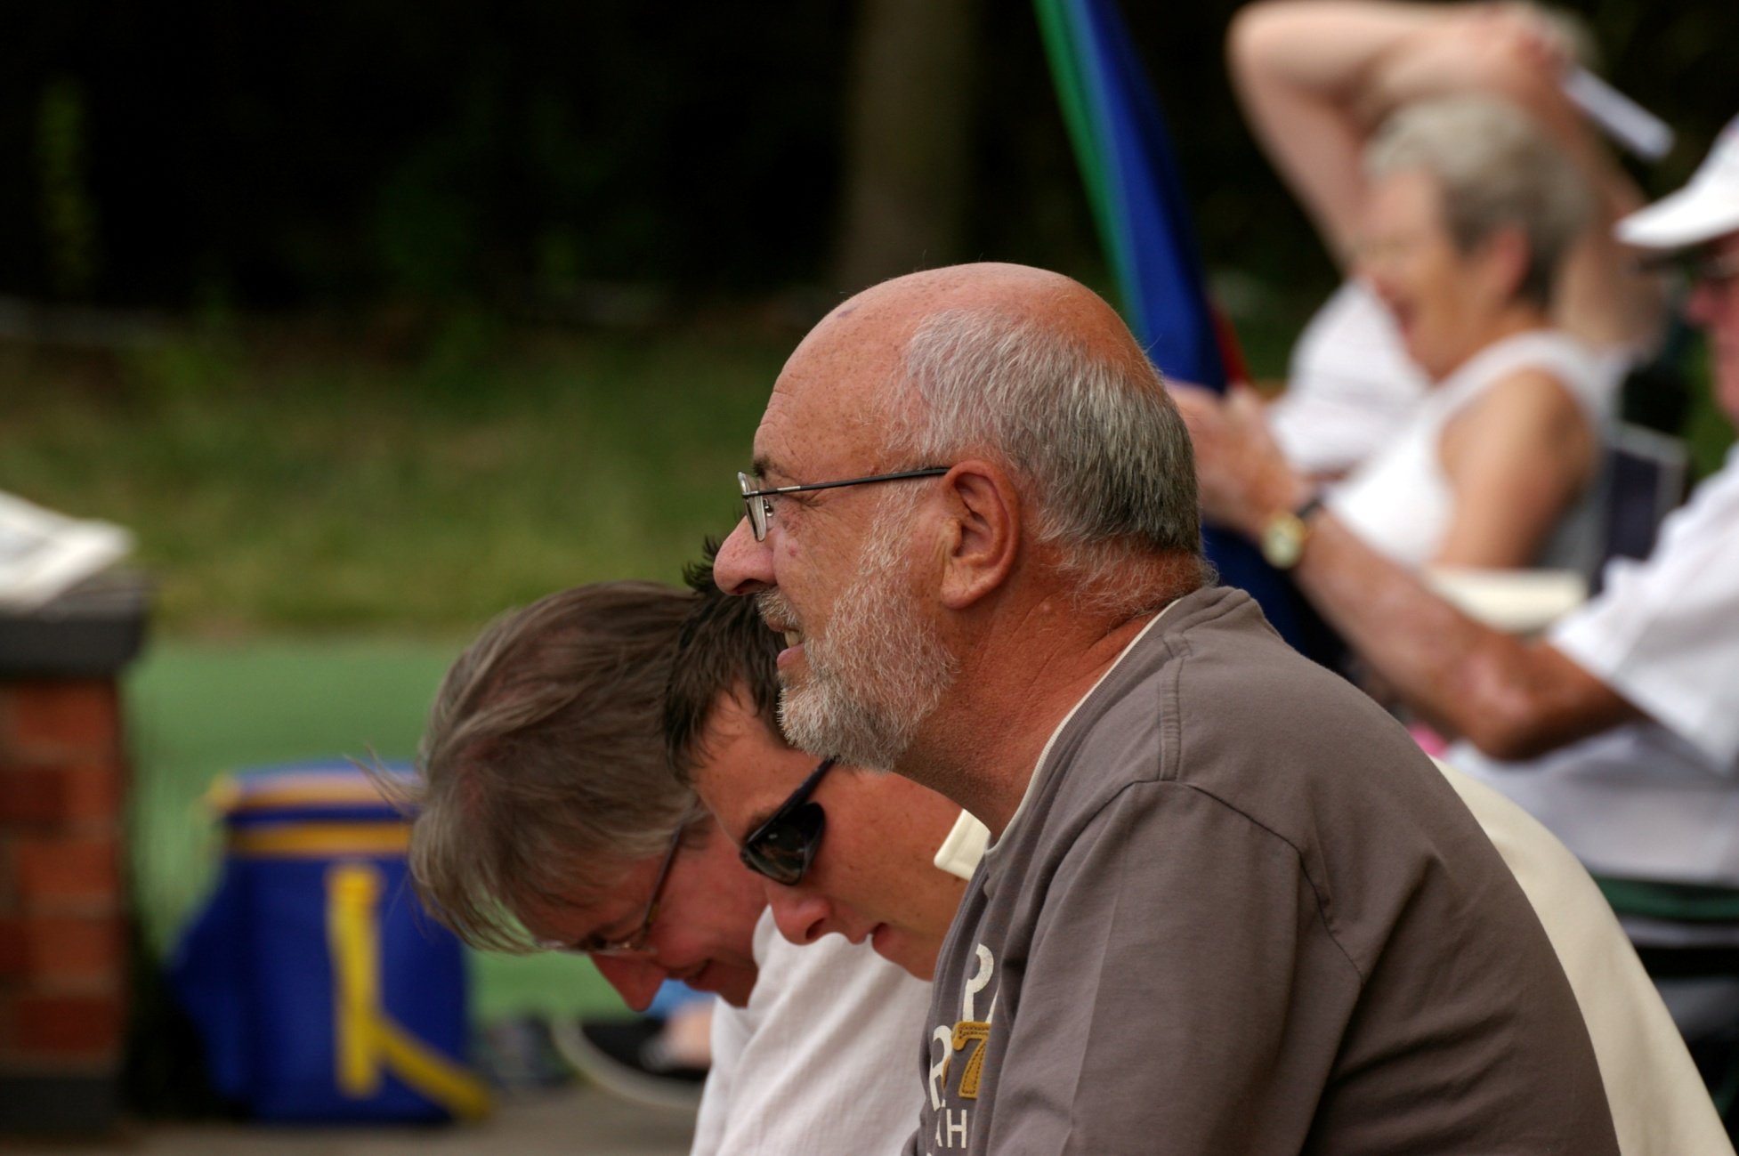
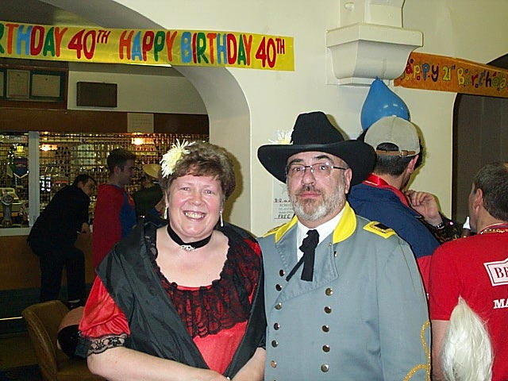
a D.C.C. ‘Great’

Slide 97
a D.C.C. ‘Great’

Slide 98
a D.C.C. ‘Great’

Slide 99
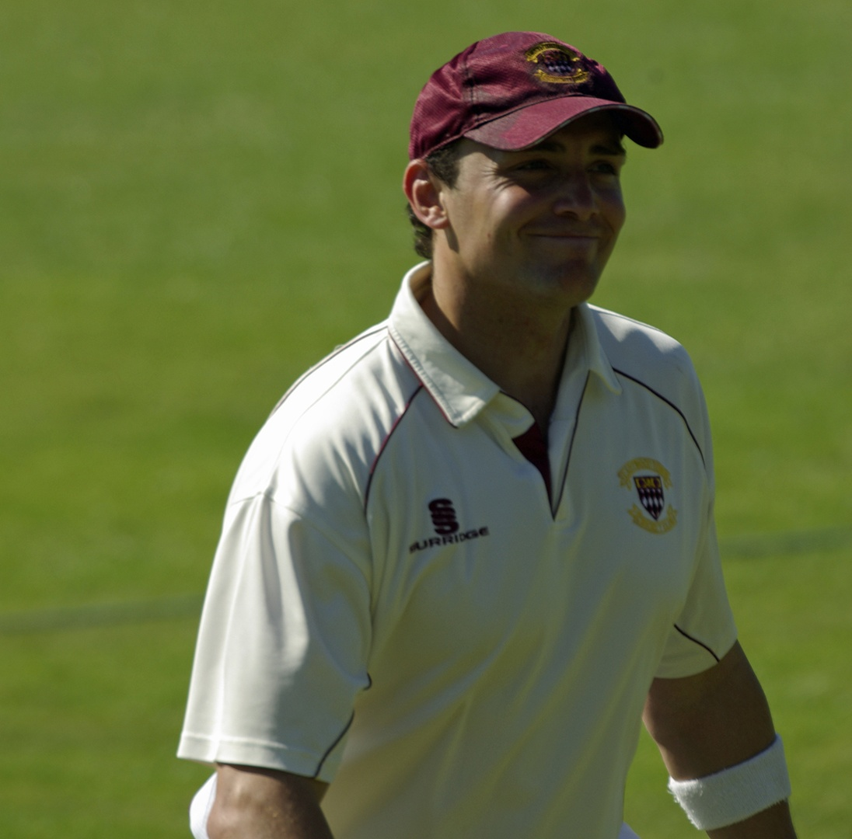
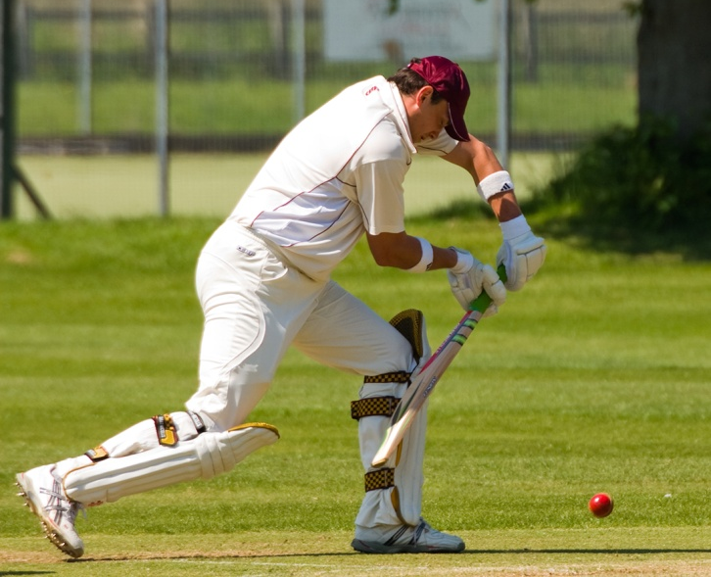
a D.C.C. ‘Great’

Slide 100
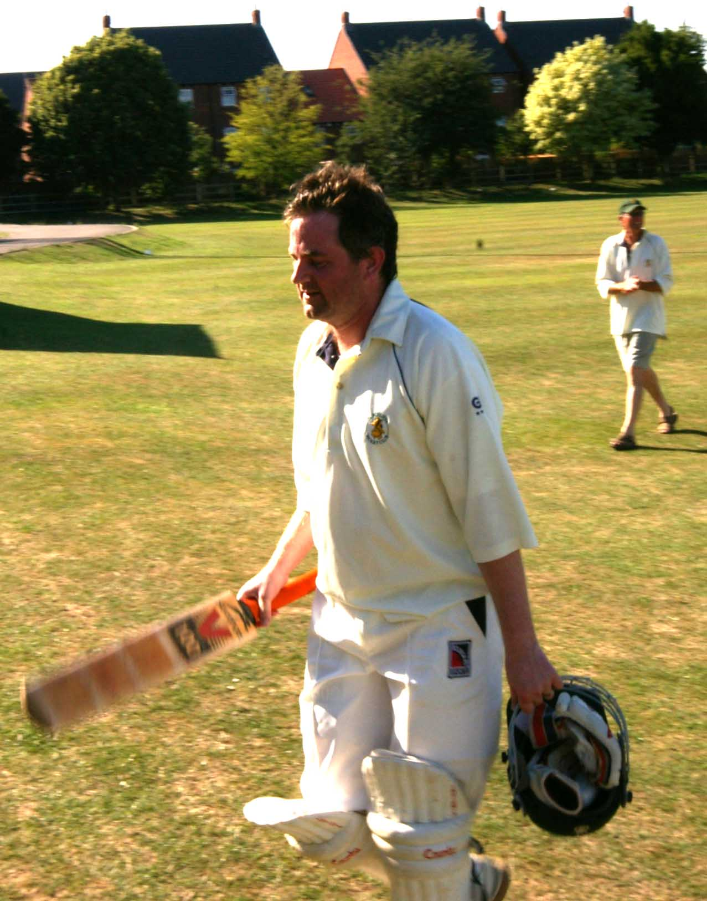
a D.C.C. ‘Great’

Slide 101
a D.C.C. ‘Great’

Slide 102
a D.C.C. ‘Great’

Slide 103
a D.C.C. ‘Great’

Slide 104
a D.C.C. ‘Great’

Slide 105
Steve Dilks – ‘Dilksy’

Slide 106
Dorchester CC
All Time Greats

Slide 107
D.C.C. All time Great -

Slide 108
D.C.C. All time Great -

Slide 109
D.C.C. All time Great -
.

Slide 110
a D.C.C. ‘all time Great’

Slide 111
D.C.C. All time Great -

Slide 112
D.C.C. All timeGreat

Slide 113
D.C.C. All time Great -

Slide 114
D.C.C. All time Great – James Lees

Slide 115
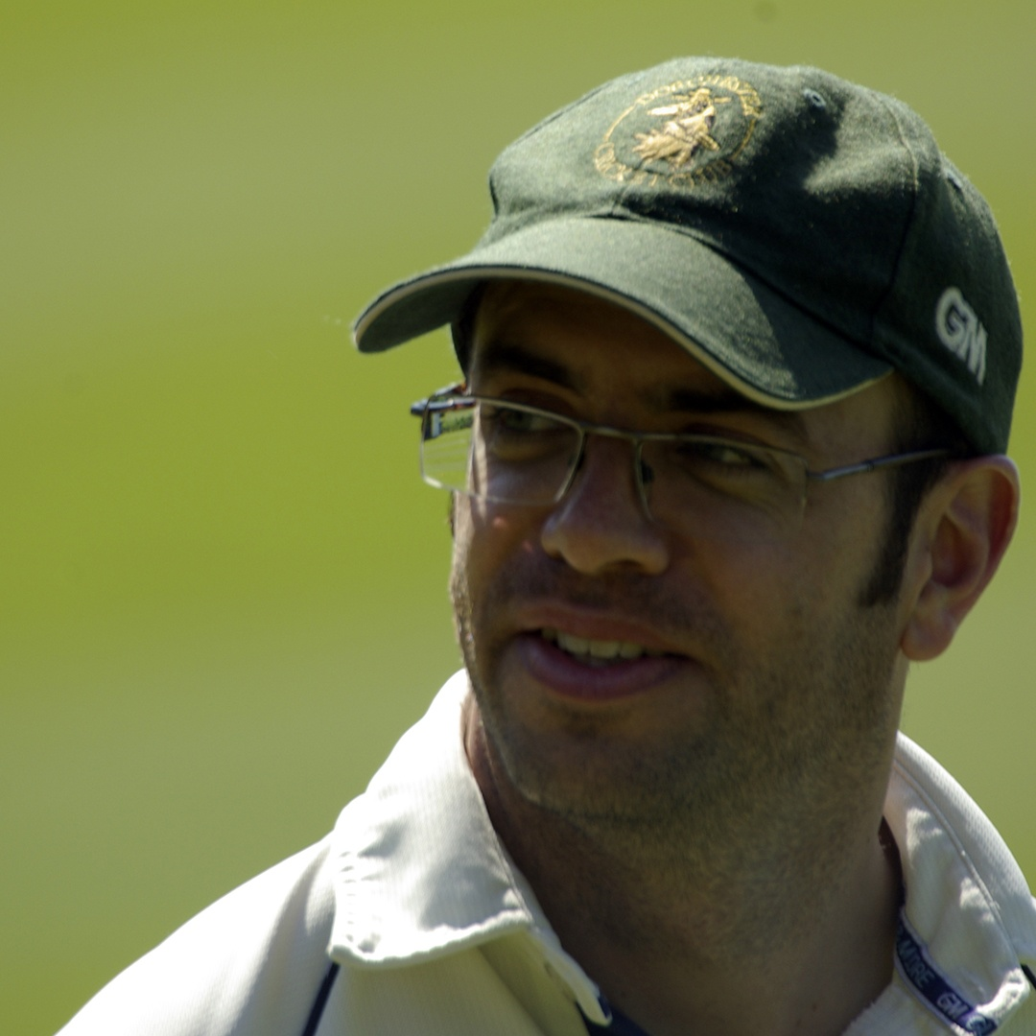

Slide 116
D.C.C. All time Great -
Hi Paul, You can put me and the wife down would not miss it for the world. Hibbo :)

Slide 117
D.C.C. All time Great -

Slide 118
D.C.C. All time Great

Slide 119
D.C.C. All time Great -

Slide 120
D.C.C. All time Great -

Slide 121
D.C.C. All time Great -

Slide 123
Split at birth?
?

Slide 124
Split at birth?

Slide 125
D.C.C. All time Great -

Slide 126
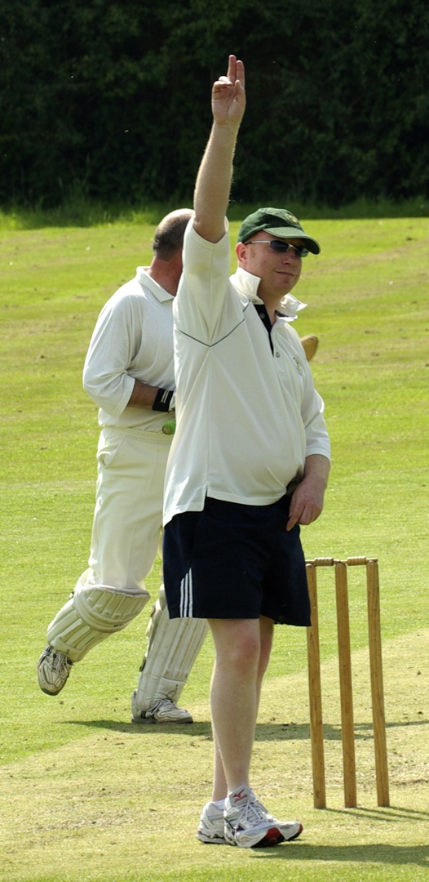
DCC All time Great

Slide 127
D.C.C. All time Great -

Slide 129
DCC Legends
1961-2011

Slide 130
DCC LEGEND – Norman Taylor

Slide 131
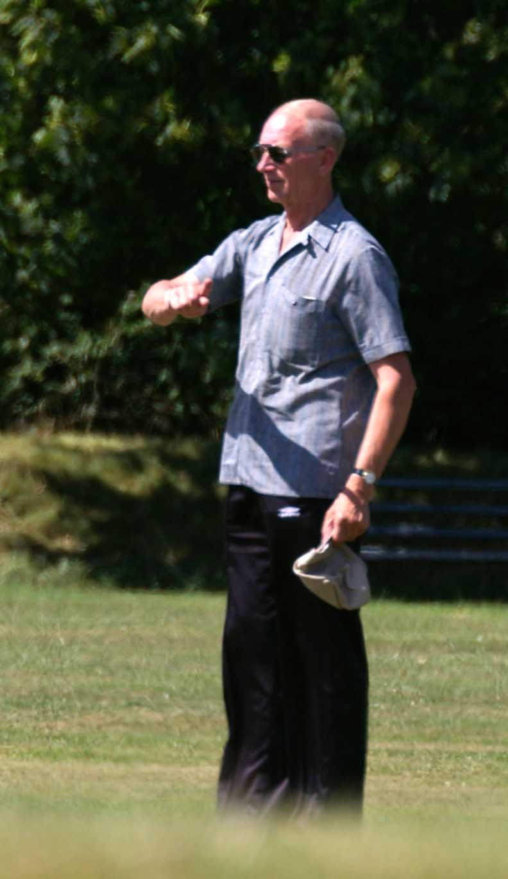
DCC Legend – Norman Taylor

Slide 132
DCC Legend – Colin Taylor

Slide 133
DCC Legend – Colin Taylor

Slide 134
DCC Legend – Paul Taylor

Slide 135
DCC Legend

Slide 136
DCC Legend – Terry Berresford

Slide 137
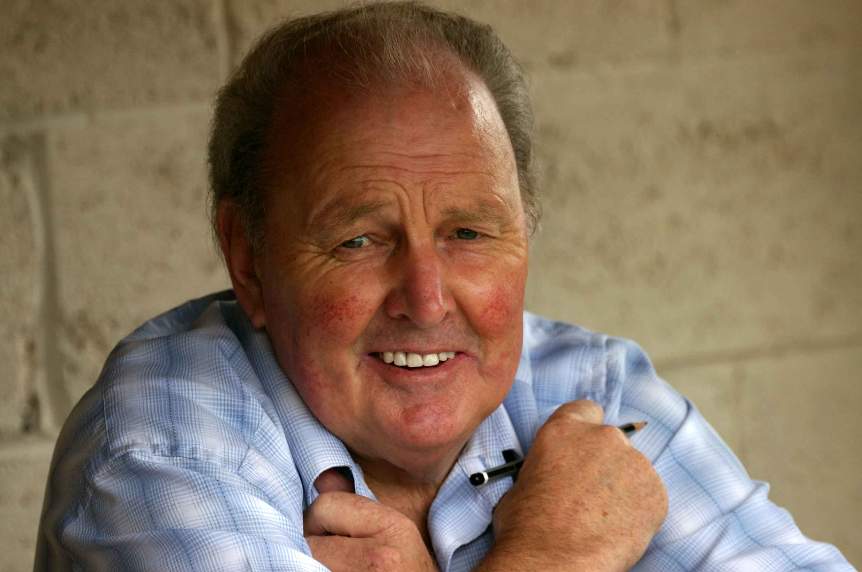

Slide 138
Final Presentation
The evening (and the Club) ended where it began with Mrs Bostock presenting an award to Terry Berresford. This replicated the act from the very first DCC do all those years before.
Terry was shaking a bit, but hung on to his glassware, just like the class keeper he was.
Terry got a standing ovation from the whole room.

Slide 139
Dorchester CC 1961-2011
Close of Play

